Slide 1
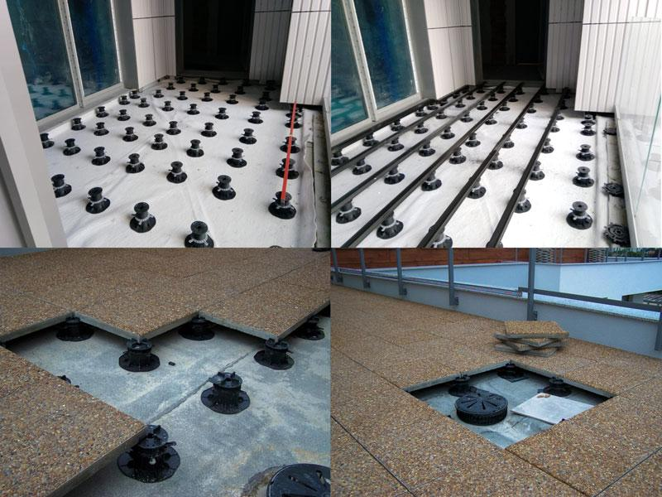

PEDESTALS
FOR PAVERS, TILES
AND DECKING
Raised outdoor flooring. Floating decks with adjustable height plastic pedestals. Support pedestals system.
Part 1
What is support pedestals system for terraces and why your customer should choose this solution?

Slide 2
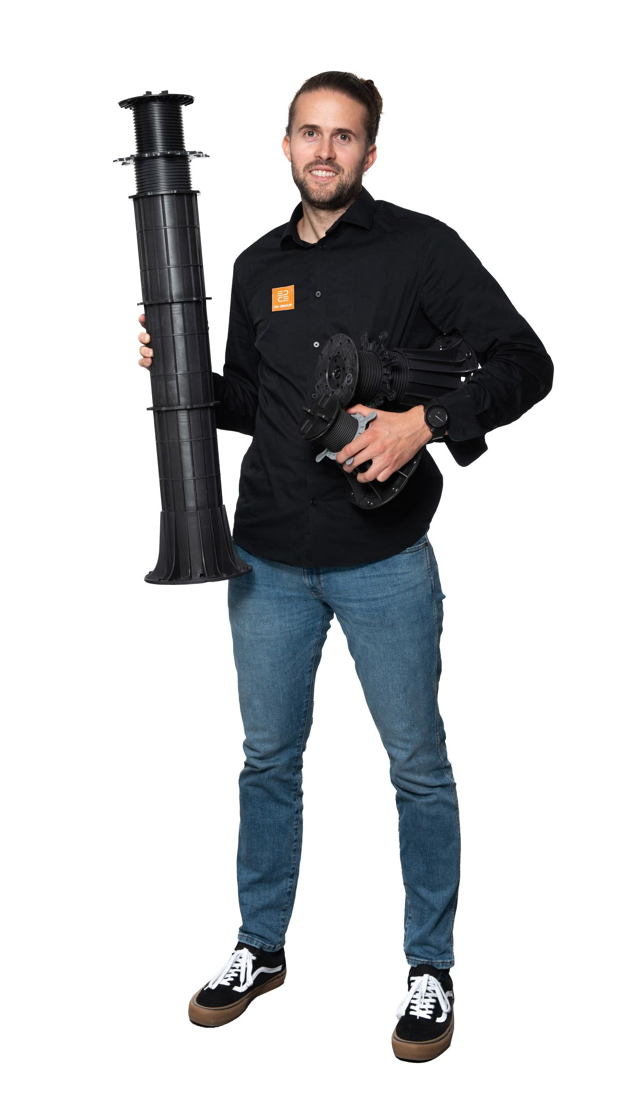
I invite You to to sign up on my newsletter list
I would like to give You a good value content about adjustable pedestals and terraces. If You will subscribe to my list I will be writing to you about:
New products
Updates
Pricelists
Technical knowledge
Interesting projects
https://ddgro.eu/en/join-our-newsletter/
Notes:
https://ddgro.eu/en/join-our-newsletter/

Slide 3




Raised outdoor
pedestal flooring
We are a manufacturer and shipping worldwide. If You are interested in cooperation please contact with us!
Move on for a reading ...
www.ddgro.eu
sales@ddpedestals.eu

Slide 4
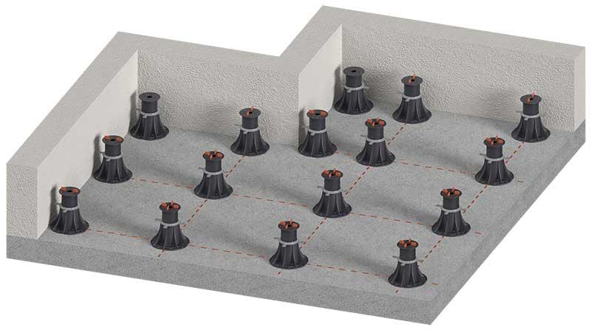
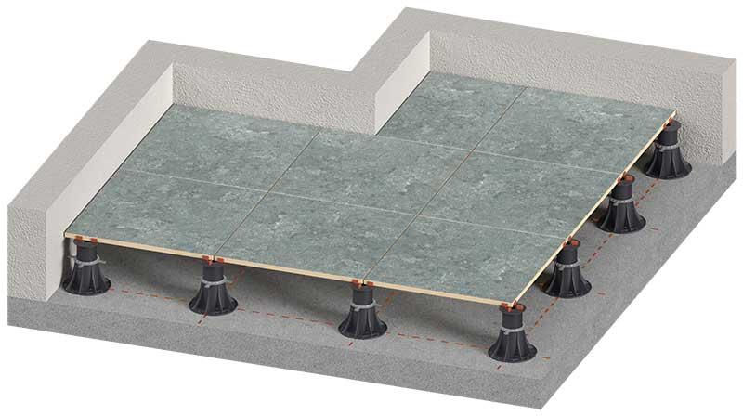
Raised outdoor
pedestal flooring
what is it?
Raised outdoor flooring is a innovative system which is ultimate solution for external terraces, decks, patios.
System allows for raising outdoor floor level to a desired height on a sloped ground.

Slide 5
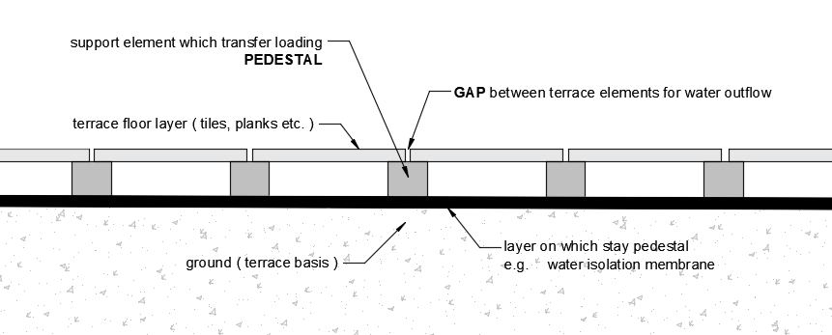
The system works in laying terrace tiles or planks on a pedestals so that they are moved away from the ground.This allows free ventilation and water flow.The system does not require gluing to the ground. Watch a Youtube video that show how pedestals works - https://youtu.be/fH9GCjYvZ5A
Raised outdoor
pedestal flooring
advantages

Slide 6

Część 1
ON THIS LEVEL WE NEED TO HAVE TERRACE TOP SURFACE
ON THIS LEVE WE HAVE CURRENT GROUND/BASIS
Taras wentylowany
czym są tarasy wentylowane?
MOŻLIWOŚĆ PODNIESIENIA POZIOMU TARASU DO ŻĄDANEJ WYSOKOŚCI

Slide 7
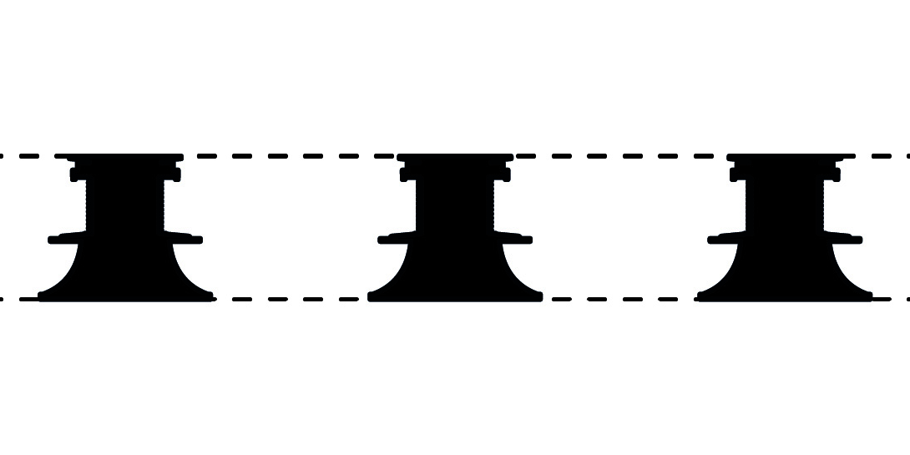
Część 1
ON THIS LEVEL WE NEED TO HAVE TERRACE TOP SURFACE
ON THIS LEVE WE HAVE CURRENT GROUND/BASIS
Taras wentylowany
czym są tarasy wentylowane?
MOŻLIWOŚĆ PODNIESIENIA POZIOMU TARASU DO ŻĄDANEJ WYSOKOŚCI

Slide 8
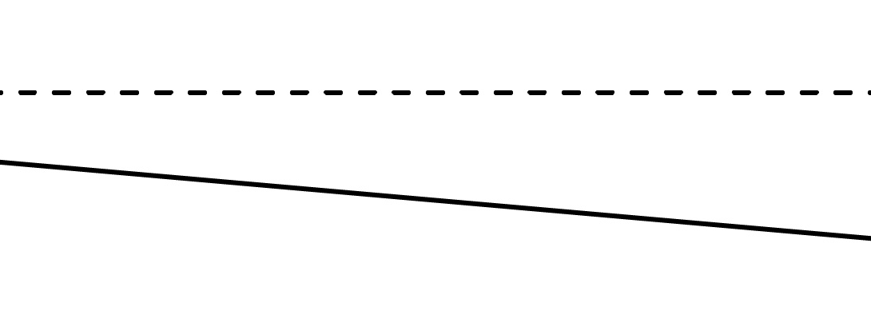
ON THIS LEVEL WE NEED TO HAVE TERRACE TOP SURFACE
Część 1
SLOPE
ON THIS LEVE WE HAVE CURRENT GROUND/BASIS
Taras wentylowany
czym są tarasy wentylowane?
POWIERZCHNIA TARASU JEST POZIOMA POMIMO IŻ POD SPODEM TARASU JEST SPADEK

Slide 9
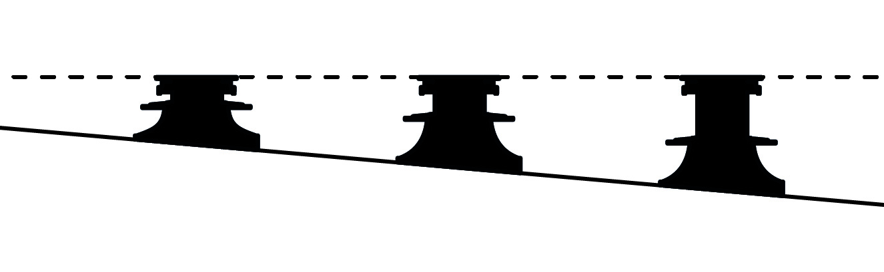
ON THIS LEVEL WE NEED TO HAVE TERRACE TOP SURFACE
Część 1
ON THIS LEVE WE HAVE CURRENT GROUND/BASIS
SLOPE
Taras wentylowany
czym są tarasy wentylowane?
POWIERZCHNIA TARASU JEST POZIOMA POMIMO IŻ POD SPODEM TARASU JEST SPADEK

Slide 10
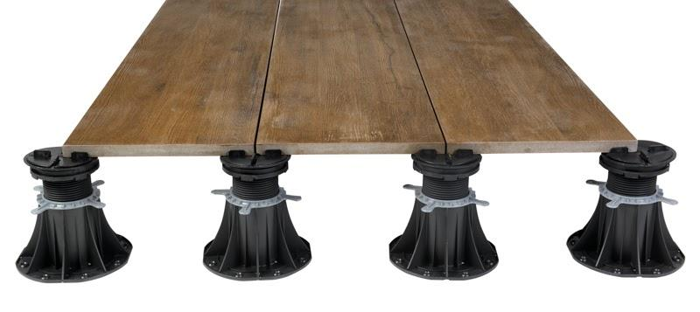
level and set the height of the terrace
no need to glue to the ground
no freezing effect
allow for an aesthetic finish
do not damage the insulation
they provide insulation and repair options
easy assembly and disassembly
Raised outdoor
pedestal flooring
advantages

Slide 11
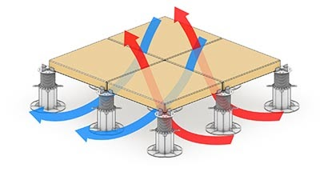
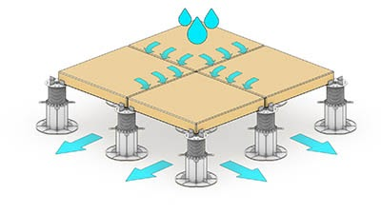
Ventilation of the entire floor
Free drainage
Raised outdoor
pedestal flooring
advantages

Slide 12
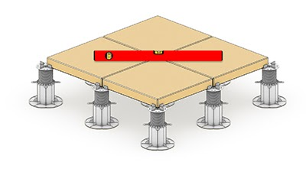
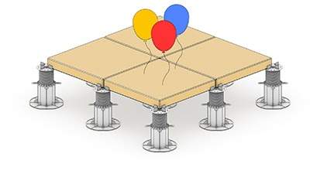
Odpowiednia wysokość i poziom tarasu
Posadzka jest lekka
Raised outdoor
pedestal flooring
advantages

Slide 13
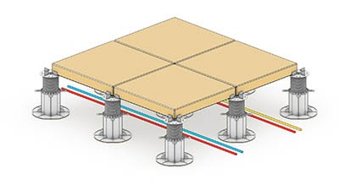
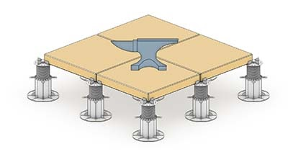
Possibility to lay cable installation media
under the terrace
The terrace is resistant to loads
Read more about advantages of raised outdoor pedestals terrace flooring https://ddgro.eu/en/articles/adjustable-deck-supports-5-most-important-advantages-of-technology/
Raised outdoor
pedestal flooring
advantages

Slide 14
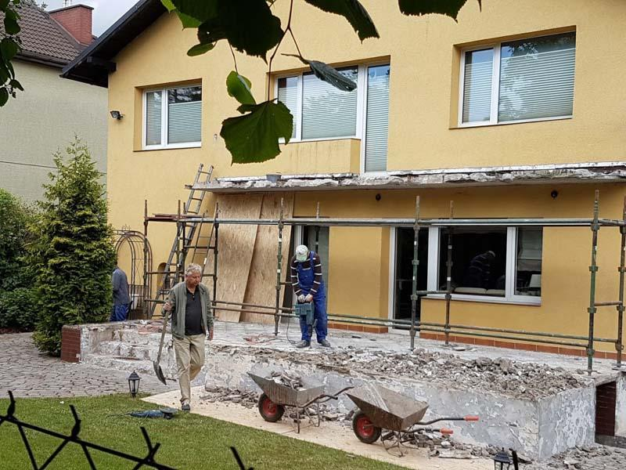
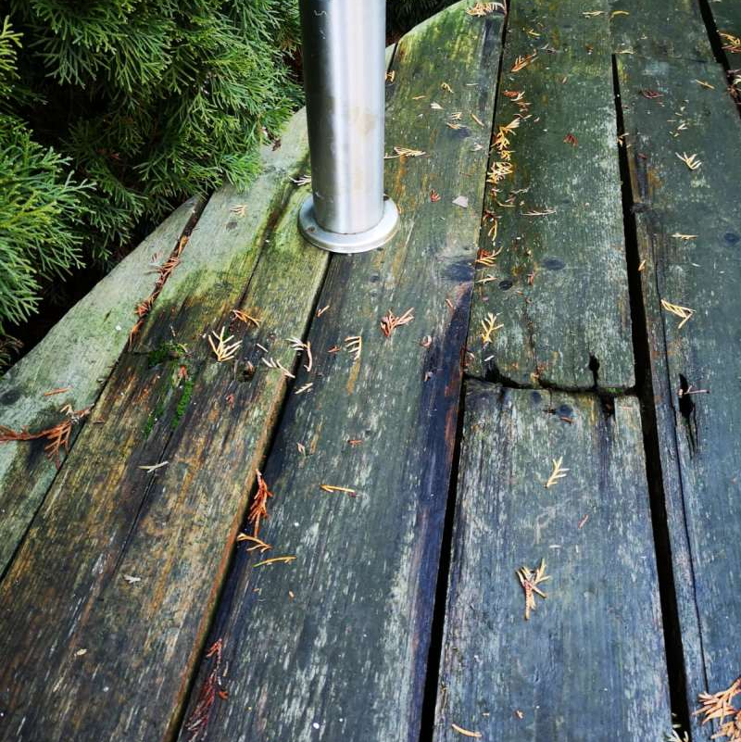

WRONG
Traditional terraces are exposed to damage shortly after completion. The main factor destroying terraces is the constant penetration of water and rot. Read more how we repaired old balcony with raised outdoor pedestals https://ddgro.eu/en/articles/balcony-repair-adjustable-pedestals/
Raised outdoor
pedestal flooring
vs. traditional solution

Slide 15
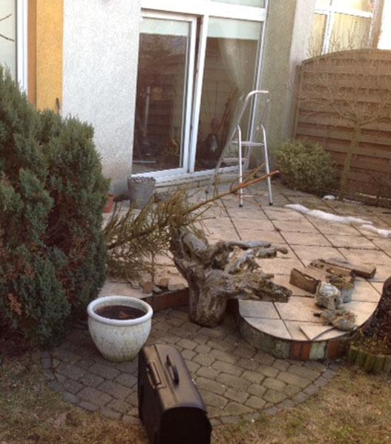
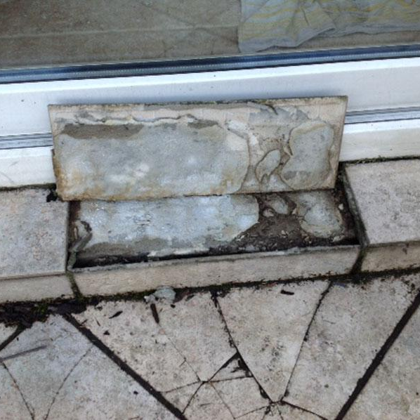
WRONG
Water penetration and freezing leads to weaning of glued tiles. Decay causes damage to the boards and the inability to use the terrace safely. The terrace surface becomes slippery and unsightly. See how we repaired old terrace with pedestals system https://ddgro.eu/en/articles/how-did-we-repair-a-terrace-of-80m2-using-a-simple-technology/
Raised outdoor
pedestal flooring
vs. traditional solution

Slide 16
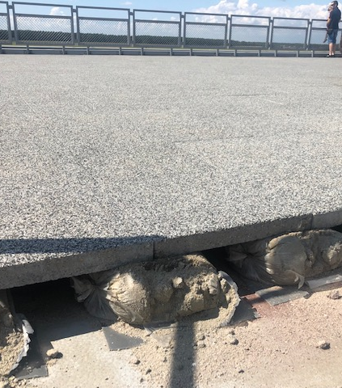
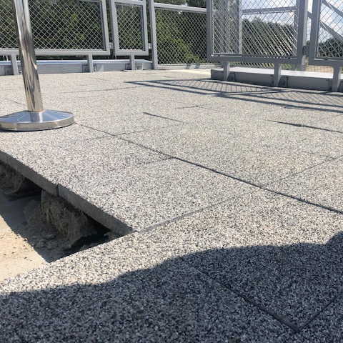
WRONG
With the invention of raised outdoor pedestal flooring, there are also attempts to make them by arranging the terraces on bags with mortar. This solution, despite being cheaper, is much more labor-intensive and faulty. Bags soaked in water crumble during frosts, which causes the terrace to collapse and be unusable.
Raised outdoor
pedestal flooring
vs. traditional solution

Slide 17
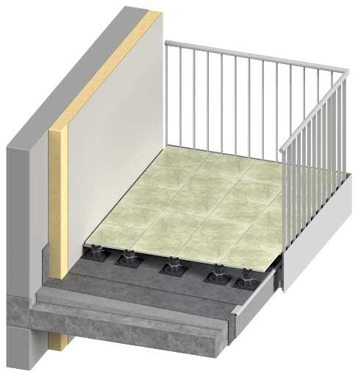
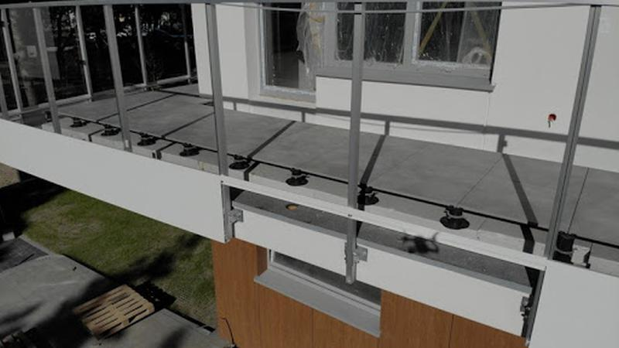
Raised outdoor
pedestal flooring
examples
BALCONIES
Terrace tiles; ceramic, stone, concrete
Read more about pedestals on balconies and watch our video from a project https://ddgro.eu/en/articles/adjustable-pedestal-installation-on-construction-site/

Slide 18
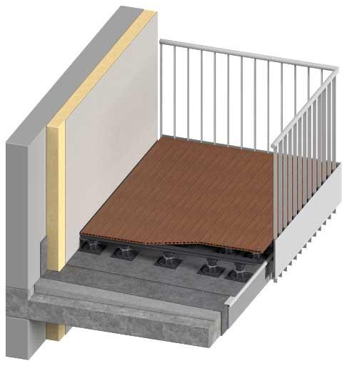
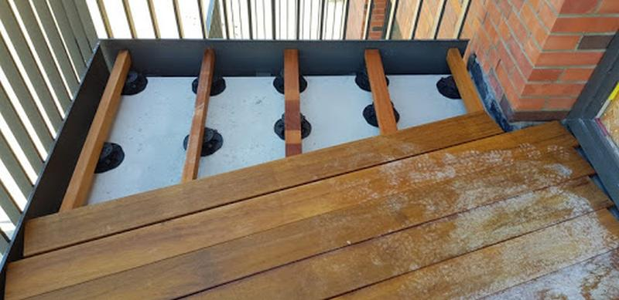
Raised outdoor
pedestal flooring
examples
BALCONIES
Terraces on joists; wooden, composite WPC. Read more about how we done project with WPC composite decking on adjustable pedestals https://ddgro.eu/en/articles/composite-decking-raised-on-pedestals-on-ground-floor/

Slide 19
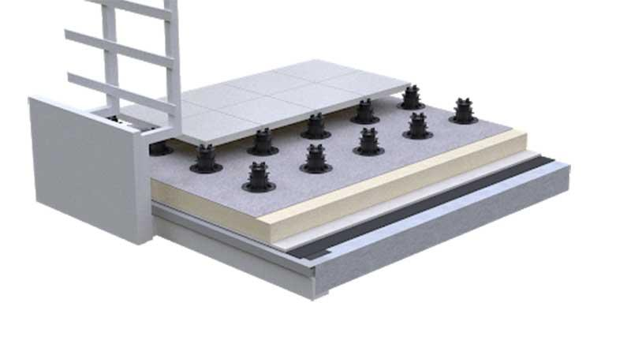
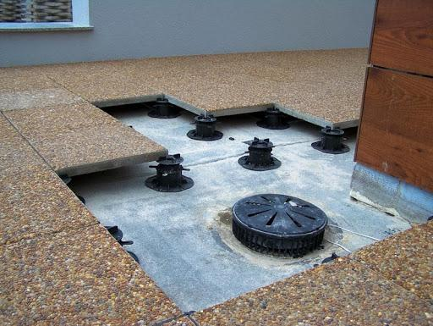
Raised outdoor
pedestal flooring
examples
FLAT ROOFS
Terrace tiles; ceramic, stone, concrete
If You are interested in pedestals for tiles visit our page with more detailed information about this type of pedestals https://ddgro.eu/en/adjustable-terrace-pedestals-for-tiles/

Slide 20
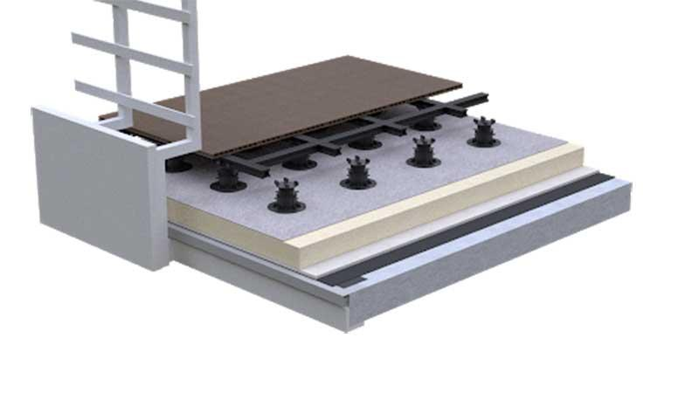
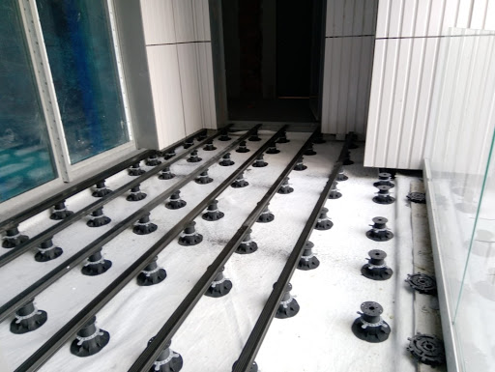
Raised outdoor
pedestal flooring
examples
FLAT ROOFS
Terraces on joists; wooden, composite WPC. See pedestals for decking joists with more detailed information https://ddgro.eu/en/adjustable-pedestals-for-decking-joists/

Slide 21
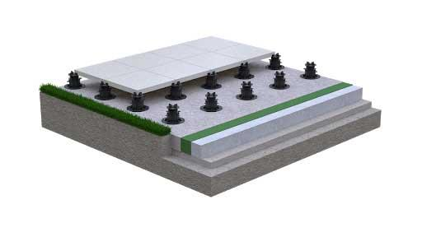
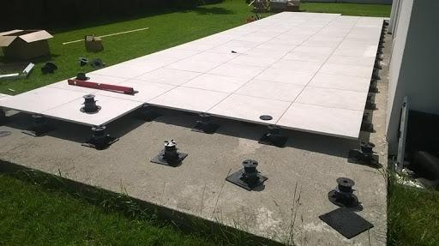
Raised outdoor
pedestal flooring
examples
ON THE GROUND
Terrace tiles; ceramic, stone, concrete

Slide 22
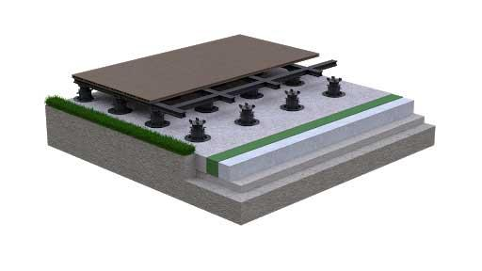
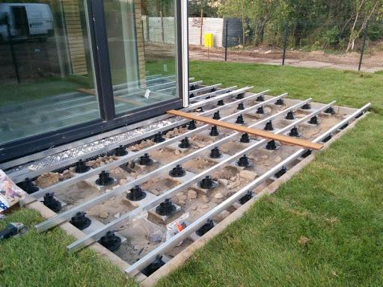
Raised outdoor
pedestal flooring
examples
ON THE GROUND
Terraces on joists; wooden, composite WPC

Slide 23
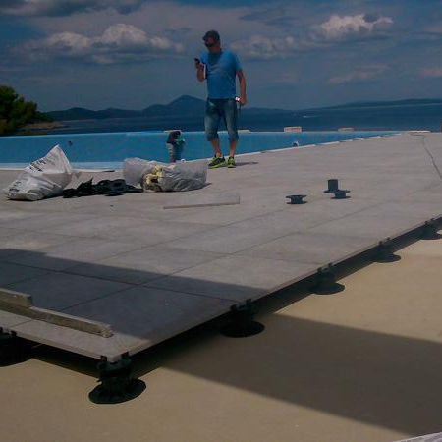
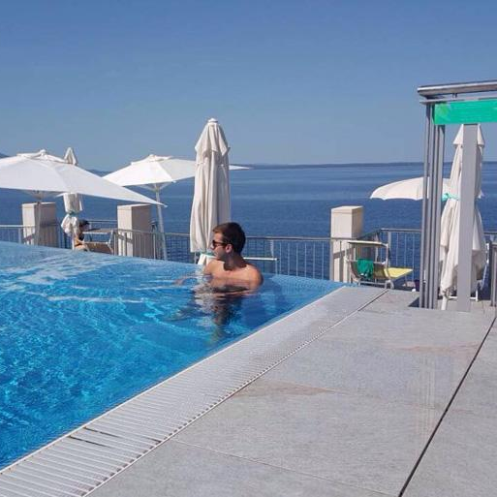
Raised outdoor
pedestal flooring
examples
SWIMMING POOLS
Terraces around the pools laid on adjustable pedestals. They allow free drainage from the terrace surface.

Slide 24
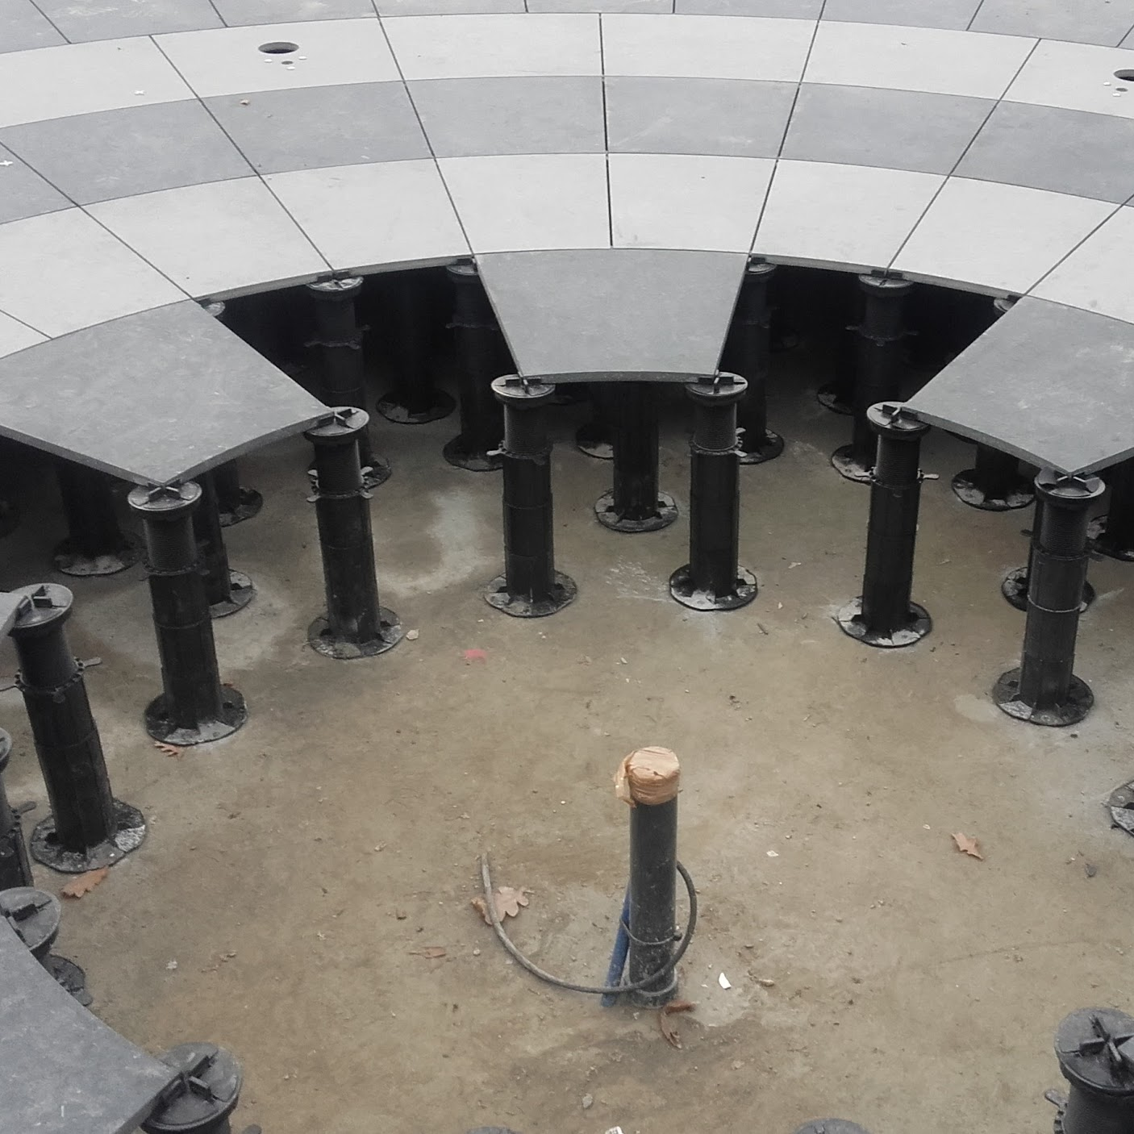
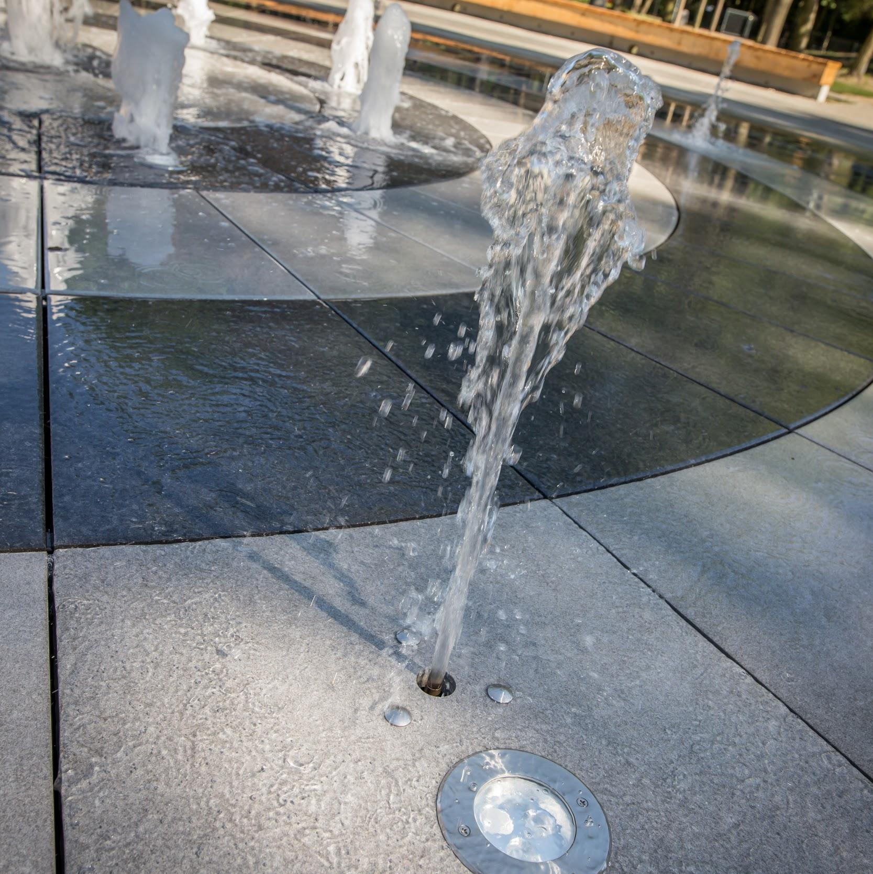
Raised outdoor
pedestal flooring
examples
FOUNTAINS
Interactive city fountains made of slabs set on adjustable pedestals.
We have a special advanced pedestals which are very good solution for fountains tiles usage. Please read more about it here https://ddgro.eu/en/adjustable-terrace-pedestals-for-tiles/

Slide 25
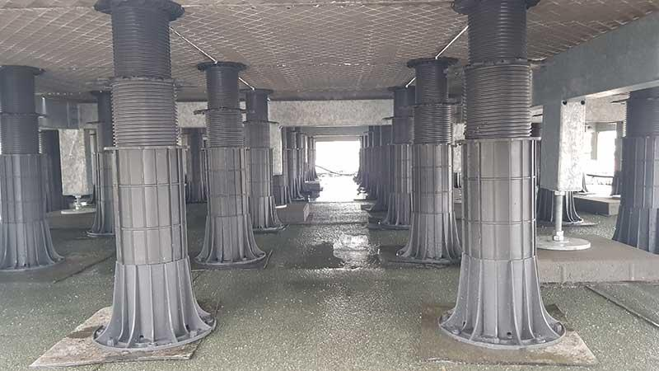
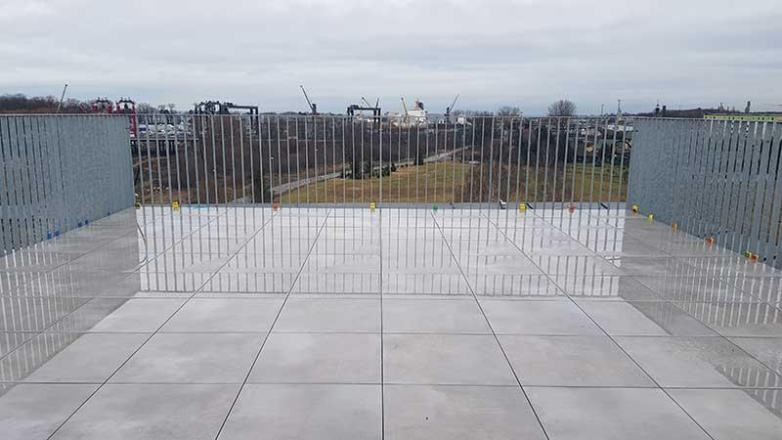
Raised outdoor
pedestal flooring
examples
ROOF TERRACE
Viewing terraces on roofs, slabs set on terrace brackets limited by a steel structure.

Slide 26
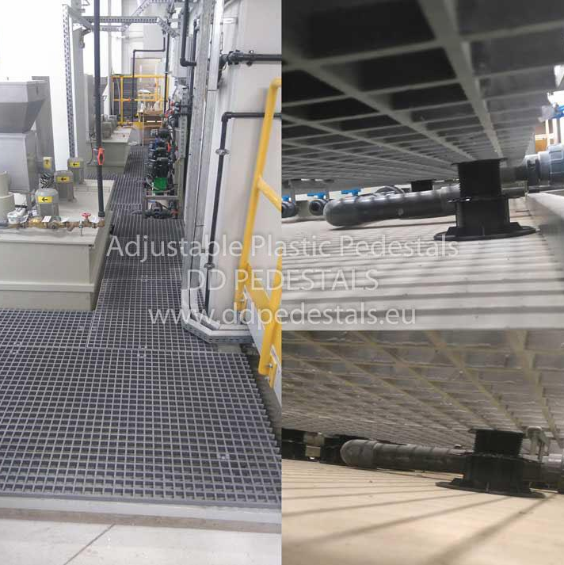
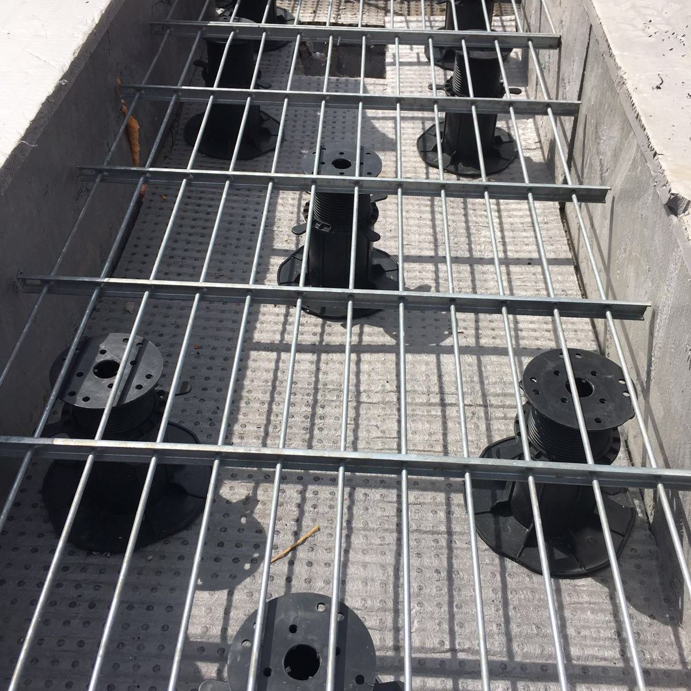
Raised outdoor
pedestal flooring
examples
STEEL CRATES
Floors raised on specialist steel gratings.

Slide 27
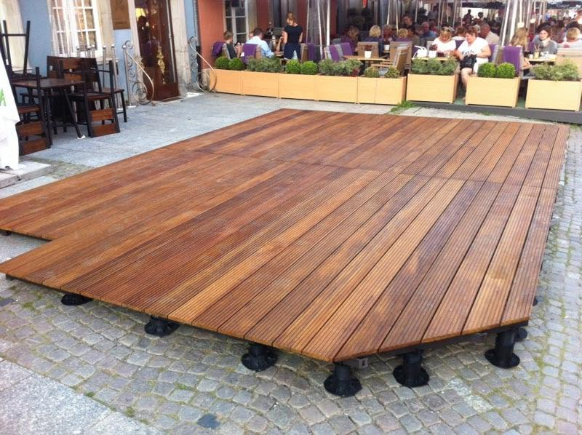
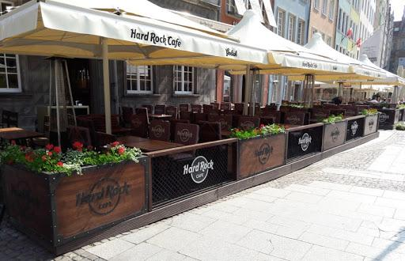
Raised outdoor
pedestal flooring
examples
RESTAURANT EXTERIOR
Raised terraces on brackets can be a solution for making restaurant exterior service gardens.

Slide 28
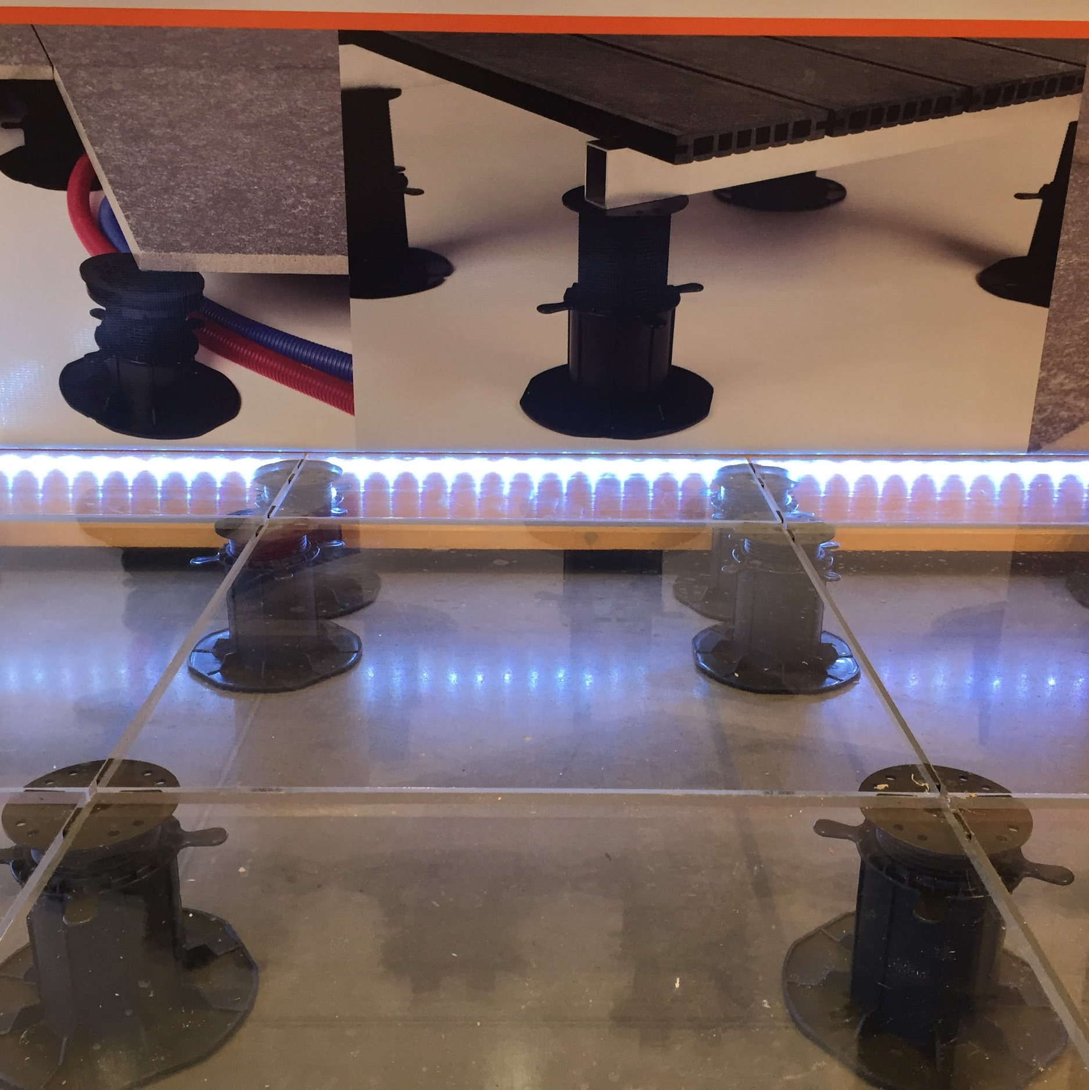
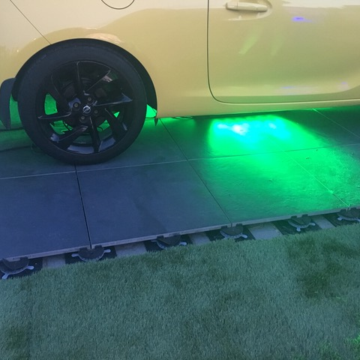
Raised outdoor
pedestal flooring
examples
EVENTS
Ventilated terraces can be used to set up market or event stands. The versatility of use allows the use of pedestals for all purpose.

Slide 29
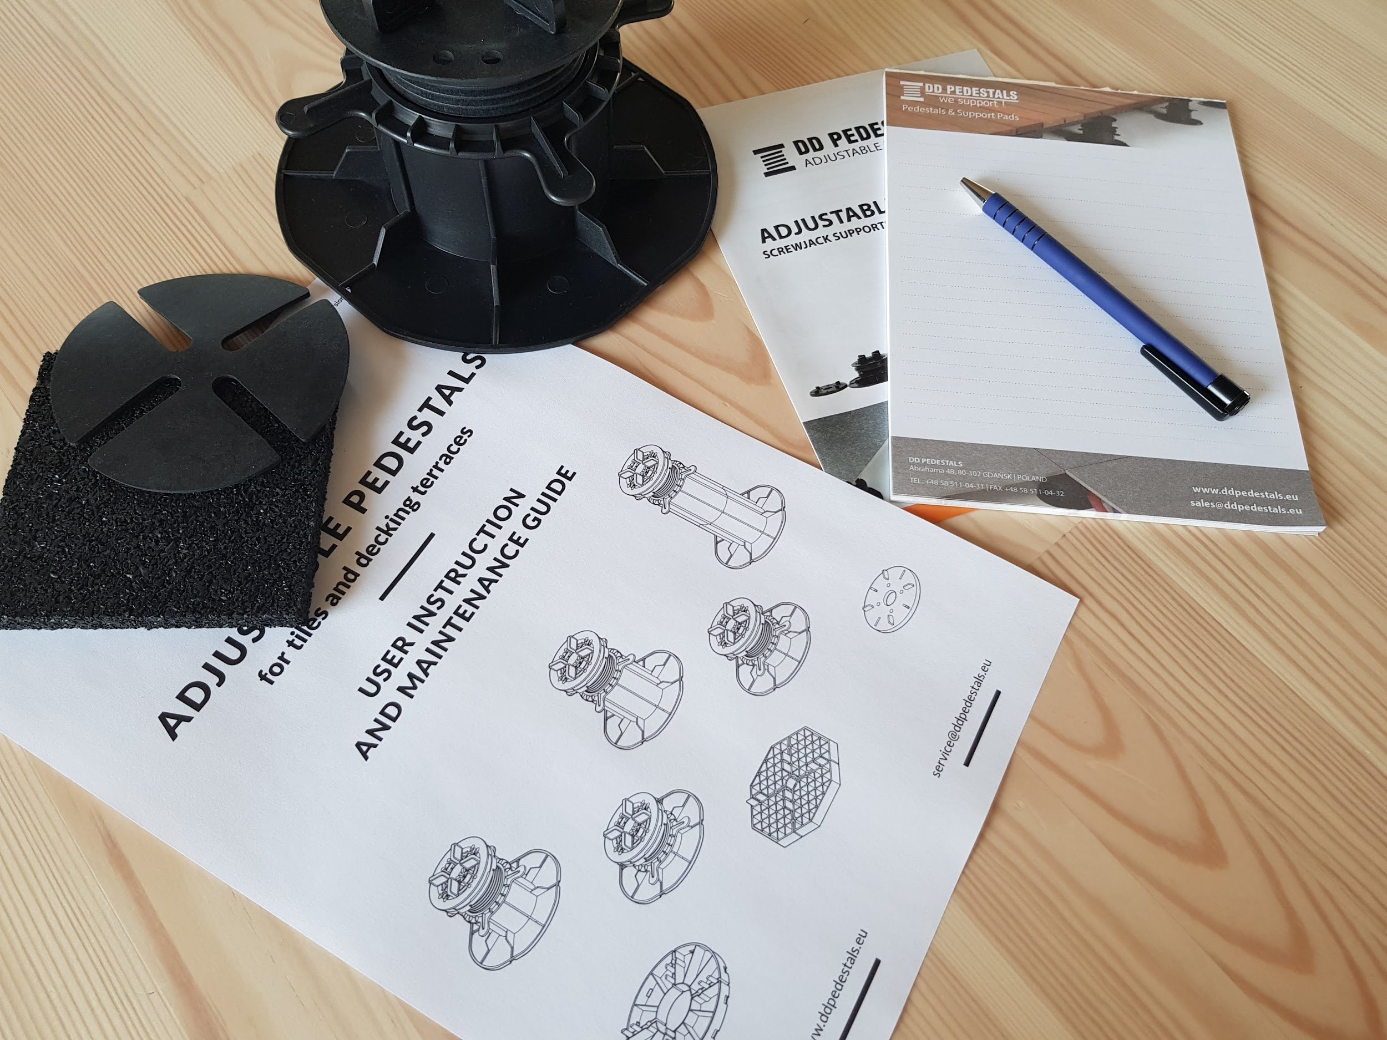
PEDESTALS
BASICS AND SETUP
Introduction to pedestals technology. Pedestals setup and how to use it.
Part 2
Basic overview over products, assembly and it`s properties

Slide 30
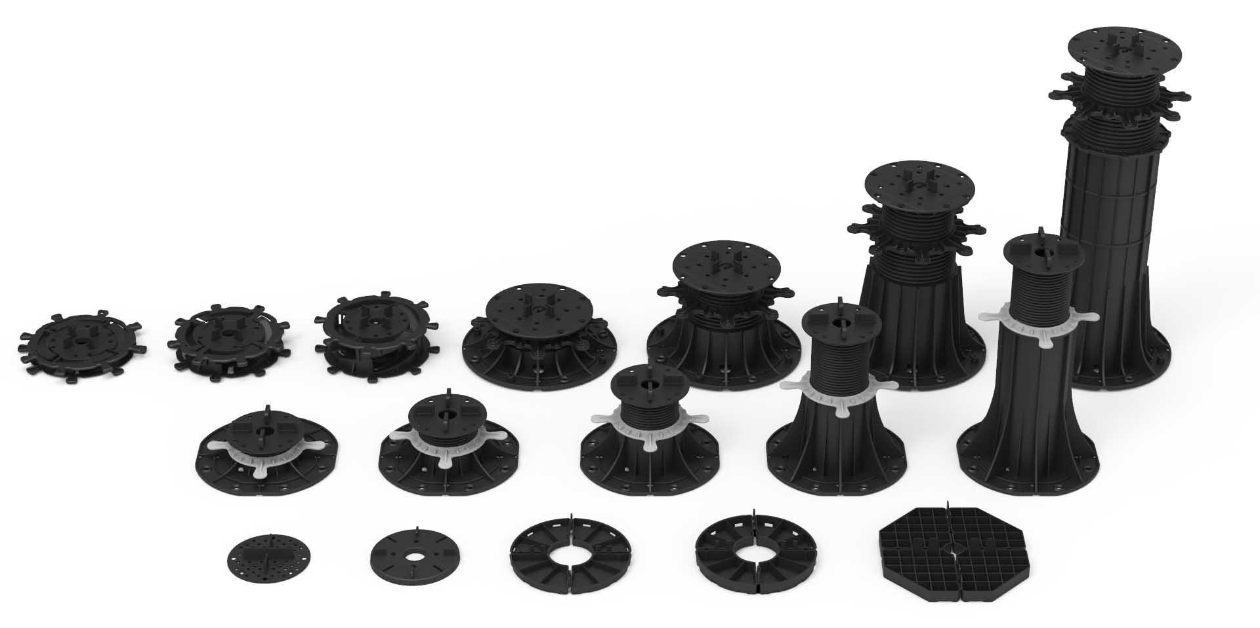
Paver & Decking PEDESTALS
Complete solution

Slide 31
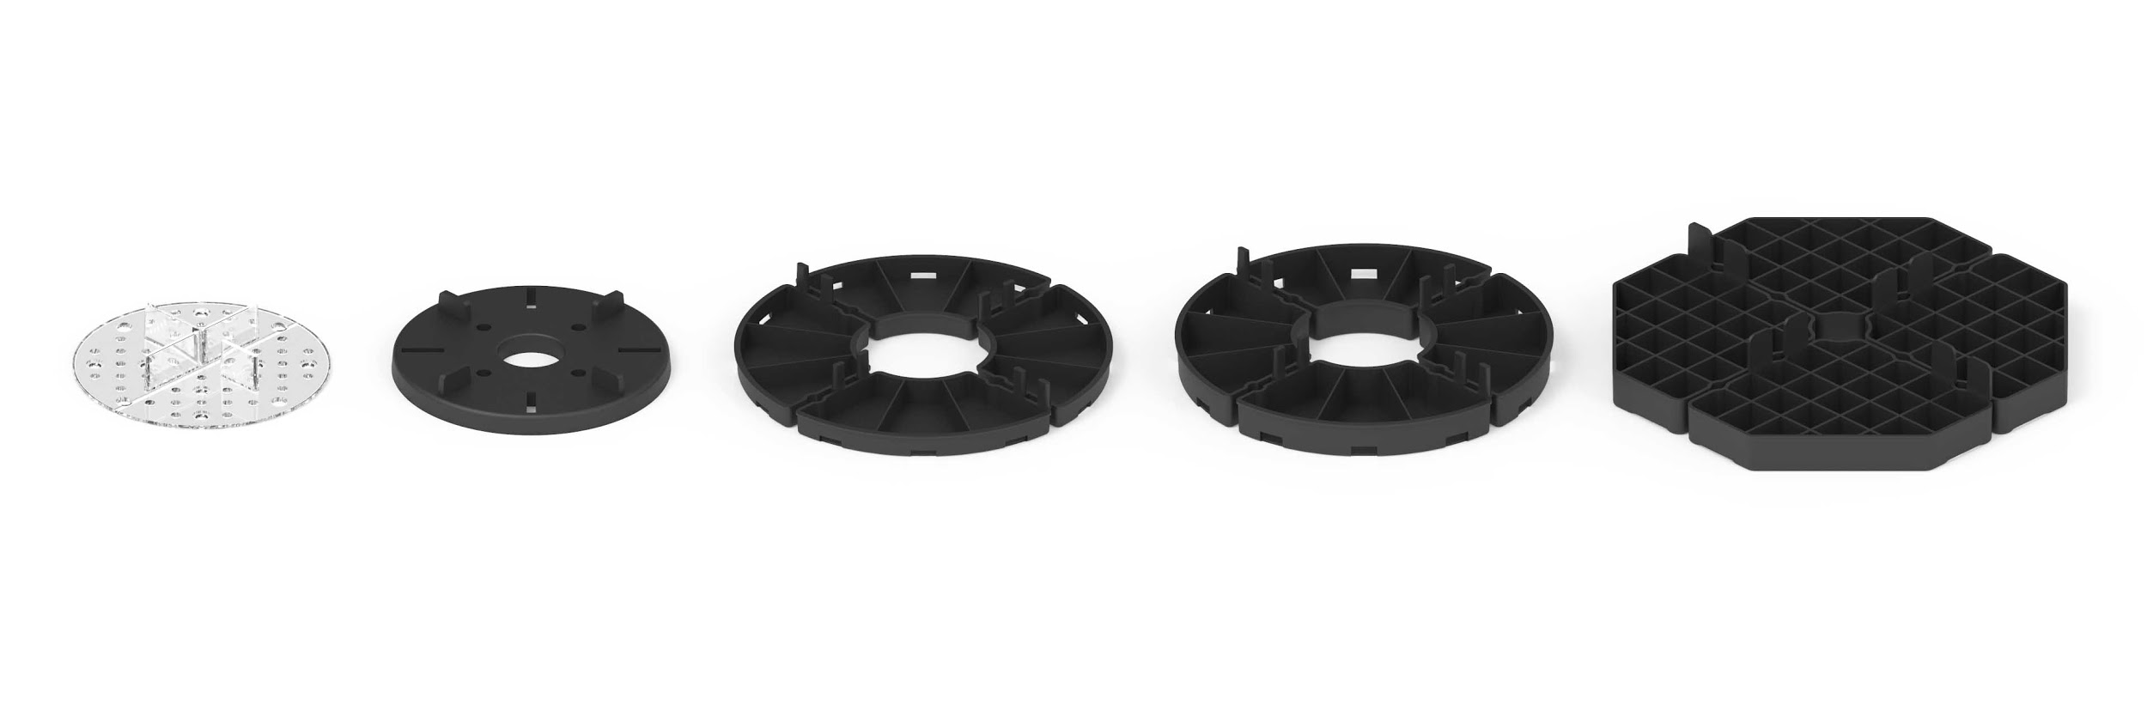
SUPPORT PADS Series
Fixed height
SUPPORT PADS

Slide 32
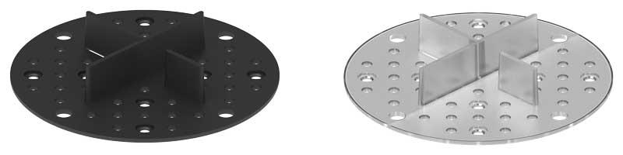
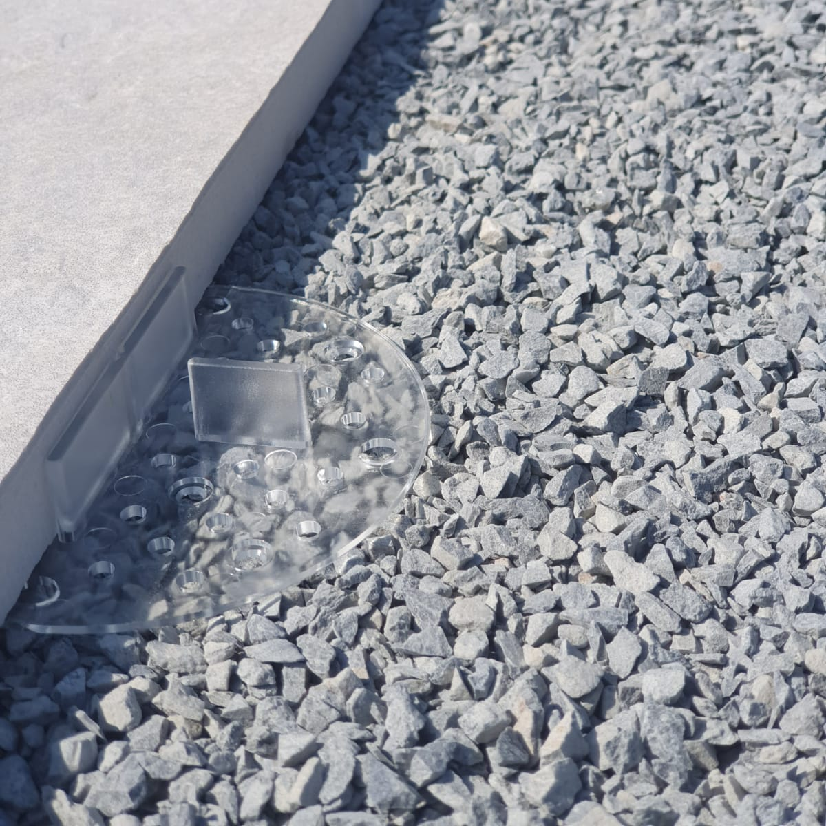
002 - 1/16 Inch - 2 mm
Transparent, Black plastic, Black rubber elastic
Built-in gap spacer ⅛” (3 mm)
SUPPORT PADS

Slide 33


002- 1/16 Inch - 2 mm
Avoid tiles displacement as on the photos.
SUPPORT PADS

Slide 34

002 - 1/16 Inch - 2 mm
Avoid tiles displacement as on the photos.
SUPPORT PADS

Slide 35

002 - 1/16 Inch - 2 mm
Avoid tiles displacement as on the photos.
SUPPORT PADS

Slide 36


008 - 5/16 Inch - 8 mm
Black rubber elastic.
Built in gap spacer ⅛” (3 mm)
SUPPORT PADS

Slide 37


008 - 5/16 Inch - 8 mm
Black rubber elastic.
Built in gap spacer ⅛” (3 mm)
SUPPORT PADS

Slide 38


008 - 5/16 Inch - 8 mm
Black rubber elastic.
Built in gap spacer ⅛” (3 mm)
SUPPORT PADS

Slide 39


010 - 3/8 Inch - 10 mm
015 - 5/8 Inch - 15 mm
Modular stackable support pads for tiles.
Built in gap spacer ⅛” (3 mm)
SUPPORT PADS

Slide 40


010 - 3/8 Inch - 10 mm
015 - 5/8 Inch - 15 mm
Modular stackable support pads for tiles.
Built in gap spacer ⅛” (3 mm)
SUPPORT PADS

Slide 41


010 - 3/8 Inch - 10 mm
015 - 5/8 Inch - 15 mm
Modular stackable support pads for tiles.
Built in gap spacer ⅛” (3 mm)
SUPPORT PADS

Slide 42


010 - 3/8 Inch - 10 mm
015 - 5/8 Inch - 15 mm
Modular stackable support pads for tiles.
Built in gap spacer ⅛” (3 mm)
SUPPORT PADS

Slide 43


016 - 5/8 Inch - 16 mm
Modular stackable support pads for tiles.
Built in gap spacer ⅛” (3 mm)
SUPPORT PADS

Slide 44


016 - 5/8 Inch - 16 mm
Modular stackable support pads for tiles.
Built in gap spacer ⅛” (3 mm)
SUPPORT PADS

Slide 45

SPIRAL Series
SPIRAL Series

Slide 46


010-017 - 0.39- 0.66 Inch (10-17 mm)
017-030 - 0.66 - 1.18 Inch (17-30 mm)
Part TOP & BOTTOM
Height increment 3/64 inch (1 mm)
Need to use with gap spacer disk
1/8” (3 mm) and 3/16” (5 mm)
Rubber shim SH145 0.059” (1,5 mm)
Self leveling head MAX 6% 5/8 inch (16 mm)
SPIRAL Series

Slide 47

Self leveling head MAX LE
Rubber shim SH 145 0.05" (1,5 mm)
Spacer discs ⅛” (3mm) or 3/16” (5mm)
Joist adapter AD
SPIRAL Series assembly and connection with accessories
SPIRAL Series

Slide 48




SPIRAL Series
New heights soon!
Part TOP & BOTTOM
Height increment 3/64 inch (1 mm)
Need to use with gap spacer disk
1/8” (3 mm) and 3/16” (5 mm)
Rubber shim SH145 0.059” (1,5 mm)
Self leveling head MAX 6% 5/8 inch (16 mm)
SPIRAL Series

Slide 49

STANDARD Series
STANDARD Series

Slide 50

Spacers
Screw
Screwnut
Base
STANDARD Series
elements
STANDARD Series

Slide 51


For tiles
For decking
STANDARD Series
elements
STANDARD Series

Slide 52


For tiles
For decking
STANDARD Series
elements
STANDARD Series

Slide 53


030-045 - 1.18-1.77 Inch (30-45 mm)
Screw, Screwnut, Base, Gap spacers / Cross spacers
Smooth height regulation
Rubber shim SH100 0.059” (1,5 mm)
Self leveling head LE 6% 5/8 inch (16 mm)
STANDARD Series

Slide 54


045-070 - 1.77-2.75 Inch (45-70 mm)
Screw, Screwnut, Base, Gap spacers / Cross spacers
Smooth height regulation
Rubber shim SH100 0.059” (1,5 mm)
Self leveling head LE 6% 5/8 inch (16 mm)
STANDARD Series

Slide 55


070-120 - 2.75-4.72 Inch (70-120 mm)
Screw, Screwnut, Base, Gap spacers / Cross spacers
Smooth height regulation
Rubber shim SH100 0.059” (1,5 mm)
Self leveling head LE 6% 5/8 inch (16 mm)
STANDARD Series

Slide 56


120-220 - 4.72-8.66 Inch (120-220 mm)
Screw, Screwnut, Base, Gap spacers / Cross spacers
Smooth height regulation
Rubber shim SH100 0.059” (1,5 mm)
Self leveling head LE 6% 5/8 inch (16 mm)
STANDARD Series

Slide 57



220-320 - 8.66-12.59 Inch
(220-320 mm)
320-420- 12.59-16.53 Inch
(320-420 mm)
Screw, Screwnut, Base, Gap spacers / Cross spacers
Smooth height regulation
Rubber shim SH100 0.059” (1,5 mm)
Self leveling head LE 6% 5/8 inch (16 mm)
STANDARD Series

Slide 58







0.05" (1,5 mm)
Cross spacer ⅛” (3mm)
Rubber shim SH100 0.05" (1,5 mm)
Self leveling head LE
Gap spacer ⅛” (3mm) or 3/16” (5mm)
STANDARD Series
accessories
STANDARD Series

Slide 59
FOR TILES
GAP SPACERS
4 tile corners support
Cross spacer ⅛” (3mm)
Up to wall gap
Gap spacer ⅛” (3mm) or 3/16” (5mm)
STANDARD Series
accessories
STANDARD Series

Slide 60

FOR TILES
GAP SPACERS
STANDARD Series
accessories
STANDARD Series

Slide 61

FOR TILES
GAP SPACERS
STANDARD Series
accessories
STANDARD Series

Slide 62

FOR TILES
GAP SPACERS
STANDARD Series
accessories
STANDARD Series

Slide 63

FOR TILES
GAP SPACERS
STANDARD Series
accessories
STANDARD Series

Slide 64
FOR TILES
GAP SPACERS
STANDARD Series
accessories
STANDARD Series

Slide 65

FOR TILES
SELF LEVELING HEAD
STANDARD Series
accessories
STANDARD Series

Slide 66

FOR TILES
SELF LEVELING HEAD
STANDARD Series
accessories
STANDARD Series

Slide 67

FOR TILES
SELF LEVELING HEAD
STANDARD Series
accessories
STANDARD Series

Slide 68

FOR TILES
SELF LEVELING HEAD
STANDARD Series
accessories
STANDARD Series

Slide 69

FOR TILES
RUBBER SHIM
SH100
STANDARD Series
accessories
STANDARD Series

Slide 70

FOR TILES
RUBBER SHIM
SH100
STANDARD Series
accessories
STANDARD Series

Slide 71

FOR TILES
RUBBER SHIM
SH100
STANDARD Series
accessories
STANDARD Series

Slide 72

FOR TILES
RUBBER SHIM
SH100
STANDARD Series
accessories
STANDARD Series

Slide 73

FOR DECKING
JOIST ADAPTER
STANDARD Series
accessories
STANDARD Series

Slide 74

FOR DECKING
JOIST ADAPTER
STANDARD Series
accessories
STANDARD Series

Slide 75


Raised outdoor
pedestal flooring
up to wall distance
Terrace floor elements should be moved away from the edge limit, e.g. a wall, to prevent damage. A dilatation clip should be used between the first / last tile and the wall.

Slide 76


Raised outdoor
pedestal flooring
up to wall distance
Terrace floor elements should be moved away from the edge limit, e.g. a wall, to prevent damage. A dilatation clip should be used between the first / last tile and the wall.

Slide 77

AKCESORIA
Vertical closure clips
Upper clip DDPEDU
Lower clip DDPEDL
To use with a STANDARD Series
Accessories

Slide 78

AKCESORIA
Vertical closure clips
Upper clip DDPEDU
Lower clip DDPEDL
To use with a STANDARD Series
Accessories

Slide 79


Raised outdoor
pedestal flooring
up to wall distance
Terrace floor elements should be moved away from the edge limit, e.g. a wall, to prevent damage. A dilatation clip should be used between the first / last tile and the wall.

Slide 80


Raised outdoor
pedestal flooring
up to wall distance
Terrace floor elements should be moved away from the edge limit, e.g. a wall, to prevent damage. A dilatation clip should be used between the first / last tile and the wall.

Slide 81


Raised outdoor
pedestal flooring
up to wall distance
Terrace floor elements should be moved away from the edge limit, e.g. a wall, to prevent damage. A dilatation clip should be used between the first / last tile and the wall.

Slide 82


AKCESORIA
Vertical closure clips
Upper clip DDPEDU
Lower clip DDPEDL
To use with a STANDARD Series
Accessories

Slide 83


Raised outdoor
pedestal flooring
water membrane protection
If it is possible to damage the water membrane insulation, it is recommended to use SBR granulate pads underlays.

Slide 84


Raised outdoor
pedestal flooring
water membrane protection
If it is possible to damage the water membrane insulation, it is recommended to use SBR granulate pads underlays.

Slide 85

MAX Series
Professional
MAX Series

Slide 86


MAX Series
Professional
MAX Series

Slide 87



Spacers
Screw
Screwnut
Base
MAX Series
elements
MAX Series

Slide 88

Self leveling head MAX LE
Spacer discs ⅛” (3mm) or 3/16” (5mm)
Rubber shim SH 145
0.05" (1,5 mm)
Joist adapter AD
MAX Series assembly and connection with accessories
Slope corrector MAX SC
MAX Series

Slide 89




Gap spacer discs
Individual spacer tabs
Joist adapter AD
MAX Series
universal pedestal head
MAX Series

Slide 90


MAX 045-075- 1.77-2.95” Inch
(45-75 mm)
Screw, Screwnut, Base, Cross spacers
Smooth height regulation
Rubber shim SH145 0.059” (1,5 mm)
Self leveling head MAX LE 6% 5/8 inch (16 mm)
Base slope corrector 8% 5/8 inch (16 mm)
MAX Series

Slide 91


MAX 075-150 - 2.95-5.9”” Inch
(75-150 mm)
Screw, Screwnut, Base, Cross spacers
Smooth height regulation
Rubber shim SH145 0.059” (1,5 mm)
Self leveling head MAX LE 6% 5/8 inch (16 mm)
Base slope corrector 8% 5/8 inch (16 mm)
MAX Series

Slide 92


MAX 150-350 - 5.9-13.77”” Inch
(150-350 mm)
Screw, Screwnut, Base, Cross spacers
Smooth height regulation
Rubber shim SH145 0.059” (1,5 mm)
Self leveling head MAX LE 6% 5/8 inch (16 mm)
Base slope corrector 8% 5/8 inch (16 mm)
MAX Series

Slide 93


MAX 350-550 - 13.77”-21.65” Inch
(350-550mm) 1 coupler
MAX 550-750 - 21.65”-29.52” Inch
(550-750mm) 2 couplers
MAX 750-950 - 21.65”-37.40” Inch
(750-950mm) 3 couplers
Screw, Screwnut, Base, Cross spacers
Smooth height regulation
Rubber shim SH145 0.059” (1,5 mm)
Self leveling head MAX LE 6% 5/8 inch (16 mm)
Base slope corrector 8% 5/8 inch (16 mm)
MAX Series

Slide 94

MAX 350-550 - 13.77”-21.65” Inch
(350-550mm) 1 coupler
MAX 550-750 - 21.65”-29.52” Inch
(550-750mm) 2 couplers
MAX 750-950 - 21.65”-37.40” Inch
(750-950mm) 3 couplers
Screw, Screwnut, Base, Cross spacers
Smooth height regulation
Rubber shim SH145 0.059” (1,5 mm)
Self leveling head MAX LE 6% 5/8 inch (16 mm)
Base slope corrector 8% 5/8 inch (16 mm)
MAX Series

Slide 95

MAX 350-550 - 13.77”-21.65” Inch
(350-550mm) 1 coupler
MAX 550-750 - 21.65”-29.52” Inch
(550-750mm) 2 couplers
MAX 750-950 - 21.65”-37.40” Inch
(750-950mm) 3 couplers
Screw, Screwnut, Base, Cross spacers
Smooth height regulation
Rubber shim SH145 0.059” (1,5 mm)
Self leveling head MAX LE 6% 5/8 inch (16 mm)
Base slope corrector 8% 5/8 inch (16 mm)
MAX Series

Slide 96


MAX SELF LEVELING HEAD
MAX LE 6% 0.62” Inch (16 mm)
Consists of TOP and BOTTOM part
Built in gap spacer 1/8” (3 mm)
Possible to use with separate gap spacers 3/16” (5 mm)
Compensate slope up to 6%
MAX Series

Slide 97


BASE SLOPE CORRECTOR
MAX SC 8% 0.62” Inch (16 mm)
Consists of TOP and BOTTOM part
Compensate slope up to 8%
MAX Series

Slide 98


BASE SLOPE CORRECTOR
MAX SC 8% 0.62” Inch (16 mm)
Consists of TOP and BOTTOM part
Compensate slope up to 8%
MAX Series

Slide 99

https://youtu.be/POhH1JKUChQ
MAX FIXING TO GROUND
MAX Series

Slide 100

https://youtu.be/sLM6WI_03aI
MAX MANUAL KEY TOOL FOR FINAL HEIGHT ADJUSTMENTS
MAX Series

Slide 101


MAX UP TO WALL CLIP
MAX Series

Slide 102

MAX BRACE CONNECTION
MAX Series

Slide 103

MAX BRACE CONNECTION
MAX Series

Slide 104


MAX WINDPROOF
MAX Series

Slide 105

Adjustable pedestals DD PEDESTALS
Accessories

Slide 106


ACCESSORIES
GAP SPACERS
L3 - 3 mm ⅛ “
L5 - 5 mm 13/64”
Can be used with all pin holes of DD PEDESTALS
Allows to create every tiles layout on terrace
Accessories

Slide 107
ACCESSORIES
GAP SPACERS
L3 - 3 mm ⅛ “
L5 - 5 mm 13/64”
Can be used with all pin holes of DD PEDESTALS
Allows to create every tiles layout on terrace
Accessories

Slide 108

ACCESSORIES
Spacer discs ( rotating discs )
D3 - 3 mm
D5 - 5 mm
Can be used with SPIRAL and MAX Series
Accessories

Slide 109

ACCESSORIES
Spacer discs ( rotating discs )
D3 - 3 mm
D5 - 5 mm
Can be used with SPIRAL and MAX Series
Accessories

Slide 110

ACCESSORIES
Cross spacers
K3 - 3 mm
K5 - 5 mm
Speed up assembly process
Can be used with STANDARD Series
Accessories

Slide 111

ACCESSORIES
Cross spacers
K3 - 3 mm
K5 - 5 mm
Speed up assembly process
Can be used with STANDARD Series
Accessories

Slide 112

ACCESSORIES
Joist adapter
AD
Joist adapter for mounting decking joists as wood, WPC, aluminium.
Can be used with all DD PEDESTALS adjustable pedestals.
Accessories

Slide 113


ACCESSORIES
Joist adapter
AD
Joist adapter for mounting decking joists as wood, WPC, aluminium.
Can be used with all DD PEDESTALS adjustable pedestals.
Accessories

Slide 114


ACCESSORIES
Up to wall distance clip
DDPWA
To use with every DD PEDESTALS product. Allows to set a distance between terrace and a wall.
Accessories

Slide 115


ACCESSORIES
Protection rubber pad SBR
SBR 200
To use with every DD PEDESTALS product for additional protection for water membrane etc.
Accessories

Slide 116

ACCESSORIES
Protection rubber pad SBR
SBR 200
To use with every DD PEDESTALS product for additional protection for water membrane etc.
Accessories

Slide 117


ACCESSORIES
Rubber shims
SH100
SH145
SH175
To use with every DD PEDESTALS products
Accessories

Slide 118


ACCESSORIES
Rubber shims
SH100
SH145
SH175
To use with every DD PEDESTALS products
Accessories

Slide 119


ACCESSORIES
Drill drive bit tool
Bit tool for a drill driver can speed up process of adjustable pedestals assembly and height regulation
Accessories

Slide 120

ACCESSORIES
Drill drive bit tool
Bit tool for a drill driver can speed up process of adjustable pedestals assembly and height regulation
Accessories

Slide 121

PEDESTALS
FOR PAVERS, TILES
AND DECKING
Raised outdoor flooring. Floating decks with adjustable height plastic pedestals. Support pedestals system.
Part 3
Installation

Slide 122


Raised outdoor
pedestal flooring
installation
Step-by-step instructions for installing a raised outdoor pedestal flooring terrace provide valuable advice and tips on what to look for and before and during installation of a ventilated terrace.

Slide 123


First, make an inventory (measurement) of the terrace that will be needed to calculate the amount of materials needed to make a raised outdoor pedestal flooring terrace.
Raised outdoor
pedestal flooring measurements inventory

Slide 124


Implementation of the terrace design will allow you to accurately count the materials needed to build the terrace and facilitate assembly work.
Raised outdoor
pedestal flooring
project design

Slide 125


Wykonanie projektu tarasu pozwoli na dokładne policzenie materiałów potrzebnych do budowy tarasu oraz ułatwi prace montażowe.
Raised outdoor
pedestal flooring
heights and slopes

Slide 126

Characteristic points will appear on the laid terrace, e.g. terrace entrance, terrace corner, arch, diagonal, obstacles, e.g. roof drain.
Raised outdoor
pedestal flooring
pedestals placement

Slide 127

Set a starting point for laying the panels on the terrace. Usually, a row of panels is chosen along the main line, e.g. a wall, and at the entrance from a balcony window.
Raised outdoor
pedestal flooring
start point

Slide 128


Setting the terrace height - Entering the terrace is usually the place where we plan the height of the ventilated terrace. Properly adjusted height relative to the threshold will allow comfortable transition from room to outside. It is recommended that the height between the terrace surface and the threshold of the balcony door is not higher than (comfortable) stairs.
Raised outdoor
pedestal flooring
terrace entrance, balcony window

Slide 129


In the corner, place a pedestal without gap spacers. The pedestal must be positioned maximally in the corner. If necessary, you can gently cut the support base.
Raised outdoor
pedestal flooring
terrace corner

Slide 130

In the outer corner, place a pedestals without gap spacers. The pedestal must be positioned maximally in the corner. If necessary, you can gently cut the support base.
Raised outdoor
pedestal flooring
reverse corner

Slide 131


Compaction and cutting of pedestals. Diagonal lines require cutting terrace tiles into trapeziums or triangles. This requires a non-standard placement of DDP pedestals and proper tile matching. Sizes after cutting should be anticipated at the stage of starting the terrace construction.
Raised outdoor
pedestal flooring
diagonal

Slide 132


Cutting pedestals and tiles. Each terrace has its own unique geometry. Terraces often have arched attic walls. In this case, placing the DDP pedestals and cutting the tiles will require greater precision and density of the DDP pedestals. Curved panels should be planned already at the stage of starting the terrace construction.
Raised outdoor
pedestal flooring
arcs

Slide 133

The roof drain is usually located at the lowest point of the terrace. Due to the basket, DDP pedestals cannot be placed directly on the inlet. It is necessary to make the replacement by placing the DDP pedestals next to the roof drain on which the panel is placed, on which the target DDP pedestal supporting the terrace tiles is located.
Raised outdoor
pedestal flooring
roof drain

Slide 134


Develop a plan for the placement of pedestals paying special attention to places such as corners, thresholds, doors. The spacing of the pedestals depends on the size of the joist cross-section and the weight of the terrace. A string is helpful when running straight lines.
Raised outdoor
pedestal flooring
decking joists mounting

Slide 135


Develop a plan for the placement of pedestals paying special attention to places such as corners, thresholds, doors. The spacing of the pedestals depends on the size of the joist cross-section and the weight of the terrace. A string is helpful when running straight lines.
Raised outdoor
pedestal flooring
decking joists mounting

Slide 136


Level all joists by placing them on a pedestsls and checking the level using a bubble level. Make sure that joist joints are on the pedestals ( as on the photo above).
Raised outdoor
pedestal flooring
decking joists mounting

Slide 137


Fix the joists to the pedestals with screws and L joist adapter.
Raised outdoor
pedestal flooring
decking joists mounting

Slide 138


Mount decking planks on leveled joists laid on pedestals.
Raised outdoor
pedestal flooring
decking joists mounting

Slide 139

Raised outdoor
pedestal flooring
tiles thickness differences
Parts of rubber pads are used to level differences in the thickness of terrace tiles. In the case of an uneven terrace surface resulting from the difference in thickness of the terrace slabs, the thickness of the thickest slab should be determined and the appropriate amount of rubber pads should be placed under the other slabs.

Slide 140

Raised outdoor
pedestal flooring
tiles thickness difference
Parts of rubber pads are used to level differences in the thickness of terrace tiles. In the case of an uneven terrace surface resulting from the difference in thickness of the terrace slabs, the thickness of the thickest slab should be determined and the appropriate amount of rubber pads should be placed under the other slabs.

Slide 141


Raised outdoor
pedestal flooring
vertical edges
The outer vertical edges of the terrace can be finished with the help of terrace covers mounted on system clips for mounting covers.

Slide 142


Raised outdoor
pedestal flooring
vertical edges
The outer vertical edges of the terrace can be finished with the help of terrace covers mounted on system clips for mounting covers.

Slide 143


Raised outdoor
pedestal flooring
vertical edges
The outer vertical edges of the terrace can be finished with the help of terrace covers mounted on system clips for mounting covers.

Slide 144


Raised outdoor
pedestal flooring
2 CM porcelain tiles
Raised outdoor pedestal flooring terrace on an Isokorb balcony slab. More information about porcelain 2 CM thickness tiles you can read on our blog https://ddgro.eu/en/articles/terrace-tiles-on-adjustable-pedestals/

Slide 145
Raised outdoor
pedestal flooring
up to wall distance
Terrace floor elements should be moved away from the edge limit, e.g. a wall, to prevent damage. A dilatation clip should be used between the first / last tile and the wall.

Slide 146
Raised outdoor
pedestal flooring
up to wall distance
Terrace floor elements should be moved away from the edge limit, e.g. a wall, to prevent damage. A dilatation clip should be used between the first / last tile and the wall.

Slide 147
Raised outdoor
pedestal flooring
up to wall distance
Terrace floor elements should be moved away from the edge limit, e.g. a wall, to prevent damage. A dilatation clip should be used between the first / last tile and the wall.

Slide 148
Raised outdoor
pedestal flooring
up to wall distance
Terrace floor elements should be moved away from the edge limit, e.g. a wall, to prevent damage. A dilatation clip should be used between the first / last tile and the wall.

Slide 149


5 mm (13/64”)
3 mm (1/8”)
Raised outdoor
pedestal flooring
gap space between tiles
Gap spacers are protruding elements from the pedestals head of a certain width ( 3 / 5 mm ) that set the gap between the tiles and prevent the terrace tiles from moving.

Slide 150


Raised outdoor
pedestal flooring
gap space between tiles
The gap between the tiles (3 mm (1/8") gap in the pictures) allows free drainage of water from the terrace surface.

Slide 151


A 1.5 mm thick rubber shim is placed between the iles and the pedestal head to block out any walking noises such as sand particles etc.
Raised outdoor
pedestal flooring
rubber shim

Slide 152


A 1.5 mm thick rubber shim is placed between the iles and the pedestal head to block out any walking noises such as sand particles etc.
Raised outdoor
pedestal flooring
rubber shim

Slide 153


In the case of balconies with a balustrade, it is recommended to support the last tiles additionally on a riveted aluminium angle to the railing in order to additionally support the panel and protect it against sliding.
Raised outdoor
pedestal flooring
terrace edge balustrade

Slide 154


In the case of balconies with a balustrade, it is recommended to support the last tiles additionally on a riveted aluminium angle to the railing in order to additionally support the panel and protect it against sliding.
Raised outdoor
pedestal flooring
terrace edge balustrade

Slide 155


Raised outdoor
pedestal flooring
water membrane protection
If it is possible to damage the water membrane insulation, it is recommended to use SBR granulate pads underlays.

Slide 156
Raised outdoor
pedestal flooring
water membrane protection
If it is possible to damage the water membrane insulation, it is recommended to use SBR granulate pads underlays.

Slide 157


Raised outdoor
pedestal flooring
water membrane protection
If it is possible to damage the water membrane insulation, it is recommended to use SBR granulate pads underlays.

Slide 158


Raised outdoor
pedestal flooring
window frame
One of the many advantages of raised outdoor pedestal terrace flooring is the possibility of entering the terrace surface perfectly under the window frame. Thanks to this, the terrace has the effect of extending the floor inside the room without adverse faults.

Slide 159


Raised outdoor
pedestal flooring
window frame
One of the many advantages of raised outdoor pedestal terrace flooring is the possibility of entering the terrace surface perfectly under the window frame. Thanks to this, the terrace has the effect of extending the floor inside the room without adverse faults.

Slide 160


At the very beginning of the installation of the raised outdoor pedestal terrace flooring, the planned arrangement of the tiles should be carefully planned so that the tiles cuts allow for good support of the panels by the supports. In addition, the final visual effect is important, which must also be planned so that the panels are laid out nicely on the terrace.
Raised outdoor
pedestal flooring
tiles measuring

Slide 161

At the very beginning of the installation of the raised outdoor pedestal terrace flooring, the planned arrangement of the tiles should be carefully planned so that the tiles cuts allow for good support of the panels by the supports. In addition, the final visual effect is important, which must also be planned so that the panels are laid out nicely on the terrace.
Raised outdoor
pedestal flooring
tiles measuring

Slide 162


Raised outdoor
pedestal flooring
tiles cutting
We recommend using a water-cooled circular saw for cutting boards.

Slide 163


Along the walls and corners you can cut the base of the epdestals if you need it.
Raised outdoor
pedestal flooring
pedestal base trimming

Slide 164


Taras wentylowany
ground hardness
Pedestals are often used on the roof on hard XPS styrodur insulation boards. Remember to check the strength of the ground and the permissible surface loads on which the brackets are placed. Recommended minimum hardness of XPS 300 boards.

Slide 165



Taras wentylowany
pedestal undelay basis
Level ground. The ground on which the pedestals are placed should be stable and level. Clean surface, before placing pedestals clean the surface of stones, sand and other dirt that may affect the instability of the terrace pedestals.

Slide 166



Although DD PEDESTALS pedestals are characterized by great resistance to loads, it should be remembered that if their maximum strength is exceeded, they may be damaged. On ventilated terraces raised on supports, it is forbidden to drive motor vehicles and to place heavy objects, e.g. a jacuzzi bath.
Watch a Youtube video showing how durable are DD PEDESTALS - https://youtu.be/y4nBx-qd3Kg
Taras wentylowany
pedestals durability

Slide 167
Thanks for reading!
We invite You to stay in touch with us.
Bonus ...
www.ddgro.eu
sales@ddpedestals.eu

